Slide 1

Functions of a Business

Slide 2

Learning Target
Define Functions of Business
Explain the main functions of a business
Identify necessary functions for my business

Slide 3

Business Functions
Business Functions - the key activities that a business performs to provide its products or services.

Slide 4


Table Talk Activity
What do you think are the key functions of a successful business?
List three ideas on your white boards at your tables
We will share in class

Slide 5
The main functions of a business include:
Accounting & Finance
Customer Service
Sales
Human Resources
Information Technology
Operations Management
Marketing
Research & Development

Slide 6

Directions: Use the graphic organizer in your Activity Packet. Read the article. List each of the 8 main functions. List at least 4 main things that defines what each function does. When you have completed this, finish and answer the questions in Google Classroom
Function & Definition | Bullet List of some Functions
1. Operations Management - the planning, organizing, leading, and controlling company resources to achieve business goals | Sets goals
2. Sales
3. Marketing

Slide 7
Day 2
Go to Google Classroom and Complete the Assignment “Main Functions of Business Review”
Use the Activity from yesterday to answer these questions.
We will review your activity after this is complete

Slide 8

Operations Management
Operations Management: the planning, organizing, leading, and controlling company resources to achieve business goals
Includes:
Decision making
Setting goals
designing, planning, executing, and controlling the production of goods and services
managing inventory, predicting product demand, developing strategic plans

Slide 9

Sales: the process of identifying potential customers, persuading them to buy your products
Includes:
Sales professionals promoting and selling goods or services to customers (business clients or consumers)
Identifying potential customers
Build and maintain customer relationships
Assist customers with making buying decisions
Develop customer satisfaction and loyalty, fostering repeat customers

Slide 10

Marketing
Marketing: the process of creating, promoting, and selling products
Involves:
Developing a brand, logo and motto and creating effective marking and advertising campaigns
Creating strategies to promote products, and building strong customer relationships
Setting competitive pricing and promotions
Can also oversee website development, digital and social media advertising, search engine optimization and public relations
Involves advertising, packaging, event planning, and social media and email marketing

Slide 11

Research & Development (R&D)
Research & Development (R&D): a function within a business that focuses on activities aimed at innovating, creating new products, and improving or enhancing existing products
Includes Activities needed to stay competitive
Create new or Improved products
Create New technologies
Find new revenue streams
Conduct Market Research – what is trending or hot in the market

Slide 12
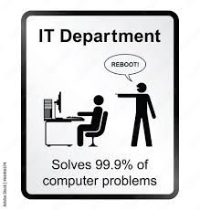
Information Technology (IT): the use of computers, software, hardware, networks, and other technologies to process, store, transmit, and manage information within a business
Includes:
Managing and using technology, software, hardware, and networks
Install and maintain security systems
Managing online transactions, processing customer orders, and tracking inventory
Ensures employees have the necessary computers, software, and network access in order to perform their job efficiently
Large companies with 50 or more employees have a dedicated IT department

Slide 13

Customer Service: the assistance and interactions provided by a business to its customers before, during, and after a purchase
Includes:
Handle customer questions, purchases, returns or issues
Addressing customer concerns,
Providing product information,
Resolving issues
Ensuring a satisfactory experience for customers

Slide 14

Human Resources (HR)
Human Resources (HR): the department responsible for managing human capital (the people that work for the business)
Includes:
Hiring and training new people
Explaining Benefits
Managing performance
Employee relations
Develop Company policies and benefits
Compliance with Laws and Regulations
Large companies with 50 or more employees have a dedicated HR department

Slide 15

Accounting
Accounting: the process of recording, summarizing, and analyzing financial transactions for a business
Includes
Tracks spending by type of purchase
Tracks income as it is earned.
Involves bookkeeping, budgeting, financial analysis, and financial reporting
Distributes paychecks
Helps determine the success of the company – making money or losing money

Slide 16

In Summary
All businesses operate differently
All businesses will choose how to complete the functions
These functions can be by department, or done by one or more :
  Businesses with 50 or more employees may have separate departments for each of the main functions
  Small businesses can be all done by 1 person or several key individuals

Slide 17
Activity: Functions of a Business Match
Directions: In your activity Packet, match each of the scenarios on page three and four to the appropriate business function.
Accounting & Finance
Customer Service
Human Resources (HR)
Information Technology (IT)
Operations Management
Marketing
Research and Development (R&D)
Sales

Slide 18
Scenarios
A team conducts market research to identify new trends and preferences in the industry.
An employee analyzes financial records, transactions, and prepares reports for stakeholders.
The company ensures its computer systems are up-to-date, secure, and operating smoothly.
The company sets up a helpline to promptly assist customers with product inquiries and issues.
A team devises a strategy to improve employee satisfaction and increase productivity.
The company invests resources to develop innovative and eco-friendly products for the market.
A team successfully convinces a potential client to sign a long-term contract for services.
A team conducts interviews and selects candidates for open positions within the organization.
The company streamlines its manufacturing process to reduce costs and increase efficiency.
An employee uses data analytics to study customer behavior and optimize marketing efforts.
The company implements a budgeting plan to allocate funds for various projects and operations.
An employee negotiates a partnership agreement with another company to expand the business.
The company's representatives handle complaints and resolve issues professionally.
A team organizes training programs to enhance employees' skills and knowledge.
The company updates its website and ensures its compatibility with various devices.
The company launches a social media campaign to increase brand visibility and engagement.
A team conducts surveys to identify potential customers for a new product.
The company experiments with different materials to improve the durability of its products.
An employee analyzes the return on investment (ROI) of an ad campaign to assess its effectiveness.
A team sets company goals and plans strategies to achieve them.

Slide 19
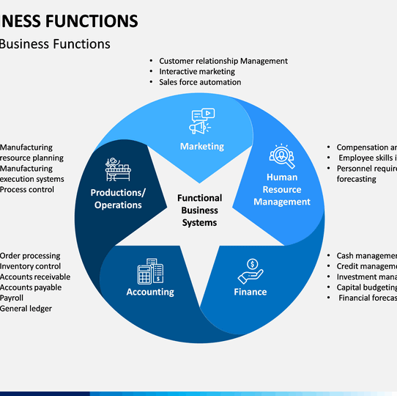
Answers

Slide 20
Quick Write in your Packet
Which function of a business interests you the most? Why is that?

